Slide 1

JavaScript, Sixth Edition
Chapter 11
Updating Web Pages with Ajax

Slide 2
Objectives
When you complete this chapter, you will be able to:
Describe the steps involved in using Ajax to update data
Create an HTTP request and interpret an HTTP response
Request and receive server data using the XMLHttpRequest object
Process data received from a web service and add it to the DOM
Update app data using JSON-P
JavaScript, Sixth Edition

Slide 3
Introduction to Ajax
Allows client web pages to quickly interact and exchange data with a web server
    Without reloading entire web page
Relies on
  Programming language such as JavaScript
  Data interchange format such as JSON or XML
JavaScript, Sixth Edition

Slide 4
Introduction to Ajax (cont’d.)
XMLHttpRequest object (XHR object)
  Uses HTTP to exchange data between a client computer and a web server
  Can be used to request and receive data without reloading a web page
JavaScript, Sixth Edition

Slide 5
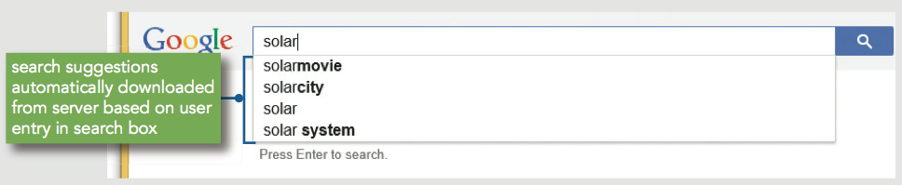
Introduction to Ajax (cont’d.)
Combining XMLHttpRequest with DHTML
  Allows update and modification to individual portions of a web page
    With data received from a web server
Google search suggestions
  One of the first commercial Ajax applications
Figure 11-1 Google search suggestions provided using Ajax
JavaScript, Sixth Edition

Slide 6
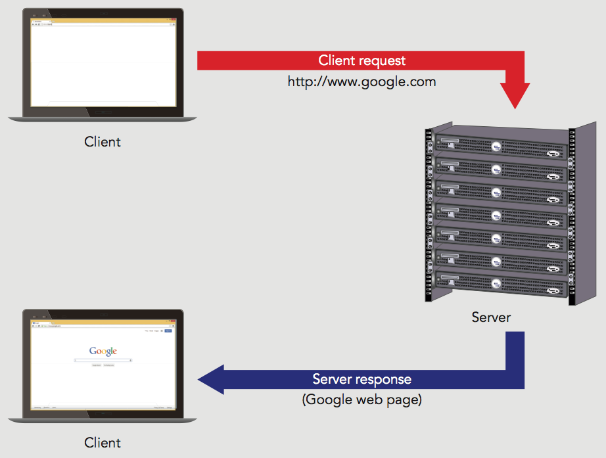
Introduction to Ajax (cont’d.)
Figure 11-2 Standard HTTP request
JavaScript, Sixth Edition

Slide 7
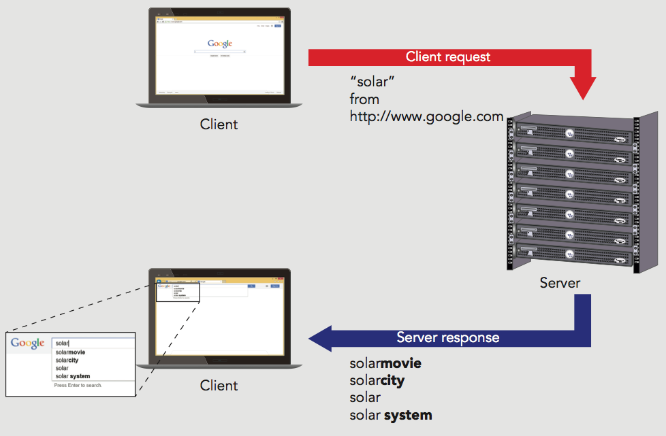
Introduction to Ajax (cont’d.)
Figure 11-3 HTTP request with the XHR object
JavaScript, Sixth Edition

Slide 8
Understanding the Limitations of Ajax
Data requested can be located on a third-party server
  Not all web servers or browsers support this
Can use a server-side script as a proxy to access data from another domain
Proxy
  Server that acts for or performs requests for other clients and servers
JavaScript, Sixth Edition

Slide 9
Accessing Content on a Separate Domain
Web service
  Data source made available on one domain for use on other domains across web
  Does not contain graphical user interface or command-line interface
  Simply provides services and data in response to requests
    Up to the client to provide an implementation for a program calling a web service
  Often requires API key
    Unique identifier assigned by service to each person/organization that wants access
JavaScript, Sixth Edition

Slide 10
Accessing Content on a Separate Domain (cont'd.)
Proxy scripts often written in PHP
  Language specifically designed to run on web servers
JavaScript, Sixth Edition

Slide 11
Running Ajax from a Web Server
Must open Ajax files from a web server
  With the HTTP (http://) or HTTPS (https://) protocol
Can install server software on any computer
Popular web server software
  Apache HTTP Server
  Nginx ("engine-ex")
  Microsoft Internet Information Services (IIS)
JavaScript, Sixth Edition

Slide 12
Working with HTTP
Using Ajax to update data involves 4 steps:
  Instantiate an XMLHttpRequest object for the web browser where the script will run.
  Use the XMLHttpRequest object to send a request to the server.
  Receive the response from the server containing the requested data.
  Process the data returned from the server, and incorporate the data into the app.
JavaScript, Sixth Edition

Slide 13
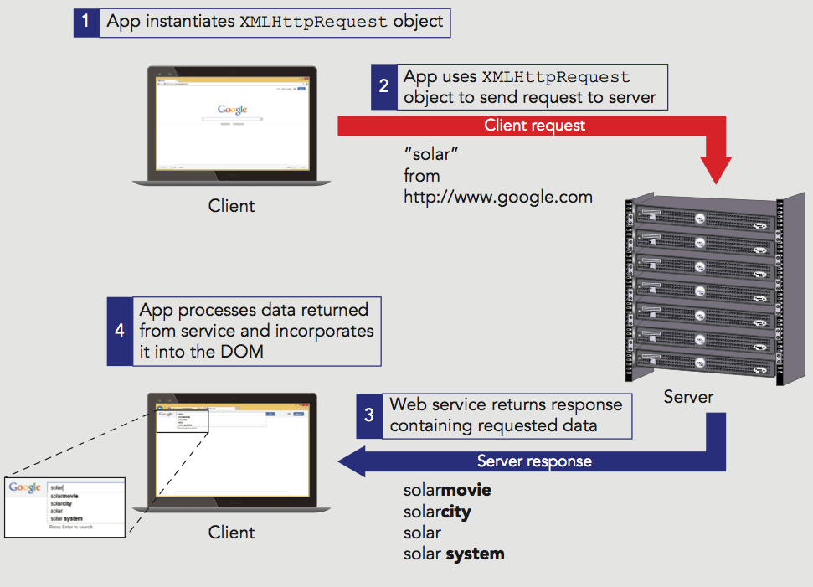
Working with HTTP (cont'd.)
Figure 11-6 Using Ajax to update data
JavaScript, Sixth Edition

Slide 14
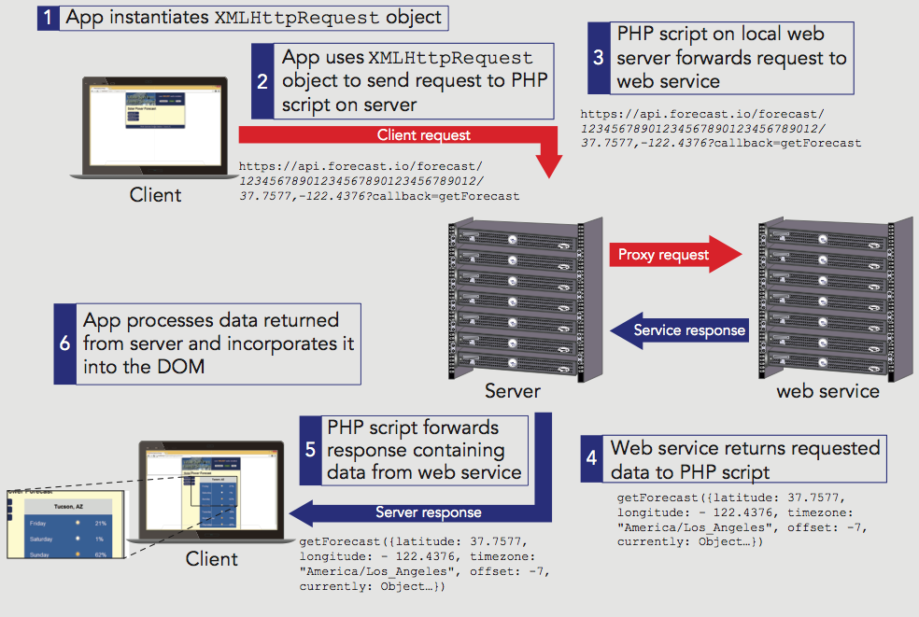
Working with HTTP (cont'd.)
Figure 11-7 Using Ajax with a proxy server to update data
JavaScript, Sixth Edition

Slide 15
Working with HTTP (cont'd.)
Request
  Process of asking for a web page from a web server
Response
  Web server’s reply
Uniform Resource Locator (URL)
  A web page's unique address
  Consists of two parts
    Protocol (usually HTTP)
    Web server’s domain name or a web server’s Internet Protocol address
JavaScript, Sixth Edition

Slide 16
Working with HTTP (cont’d.)
Hypertext Transfer Protocol (HTTP)
  Set of rules defining how requests made by an HTTP client to an HTTP server
  Defines how responses returned from an HTTP server to an HTTP client
HTTP client
  Refers to an application (web browser) making the request
HTTP server (another name for a web server)
  Refers to a computer that receives HTTP requests and returns responses to HTTP clients
JavaScript, Sixth Edition

Slide 17
Working with HTTP (cont’d.)
Host
  Computer system being accessed by a remote computer
W3C and Internet Engineering Task Force jointly develop HTTP
  Version 1.1: most recent version of HTTP commonly used today
  Version 2.0: in development
    Modern browser already support some features
JavaScript, Sixth Edition

Slide 18
Understanding HTTP Messages
HTTP messages
  HTTP client requests and server responses
HTTP client opens a connection to the server
  Submits a request message
  Web server returns a response message appropriate to the request type
Format:
  Start line (request method or status returned)
  ^{Header lines (zero or more)}
  ^{Blank line}
  ^{Message body (optional)}
JavaScript, Sixth Edition

Slide 19
Understanding HTTP Messages (cont’d.)
Headers
  Define information about the request or response message and about the contents of the message body
47 HTTP 1.1 headers
  generic headers used in request or response messages
  headers specific to a request, response, or message body
Format for using a header
    ^{header: value}
JavaScript, Sixth Edition

Slide 20
Understanding HTTP Messages (cont’d.)
Cache-Control header
  Specifies how a web browser should cache any server content it receives
Caching
  Temporary storage of data for faster access
  Web browser attempts to locate any necessary data in its cache
    Before making a request from a web server
  Goes against the reason for using Ajax
    Include Cache-Control: no-cache
JavaScript, Sixth Edition

Slide 21
Understanding HTTP Messages (cont’d.)
Blank line always follows last header line
  Optional: message body can follow the blank line in the messages
Most common types of HTTP requests
  GET and POST
Other HTTP request methods
  HEAD, DELETE, OPTIONS, PUT, and TRACE
Can use browser tools to examine HTTP headers
JavaScript, Sixth Edition

Slide 22
Sending HTTP Requests
GET method
  Used for standard web page requests
  Can have a query string or form data appended to the URL
POST request
  Similar to a GET request except that any submitted data is included in the message body
    Immediately following the blank line after the last header
JavaScript, Sixth Edition

Slide 23
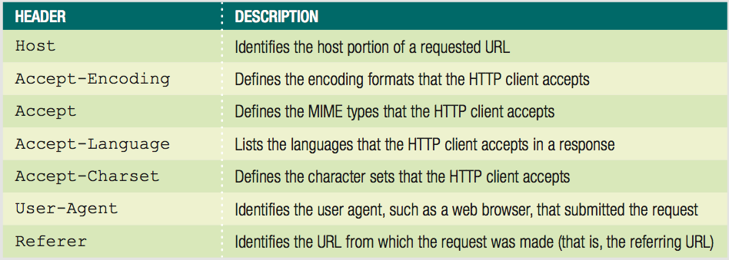
Sending HTTP Requests (cont’d.)
Table 11-1 Common request headers
JavaScript, Sixth Edition

Slide 24
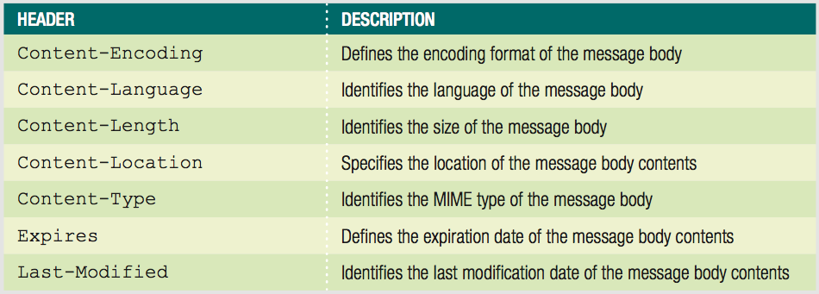
Sending HTTP Requests (cont’d.)
Table 11-2 Common message body headers
JavaScript, Sixth Edition

Slide 25
Receiving HTTP Responses
HTTP response messages
  Take the same format as request messages
  Return protocol and version of the HTTP server
    Along with a status code and descriptive text
Status codes format
  1xx: (informational) - Request received
  2xx: (success) - Request successful
  3xx: (redirection) - Request cannot be completed without further action
  4xx: (client error) - Request cannot be fulfilled due to a client error
JavaScript, Sixth Edition

Slide 26
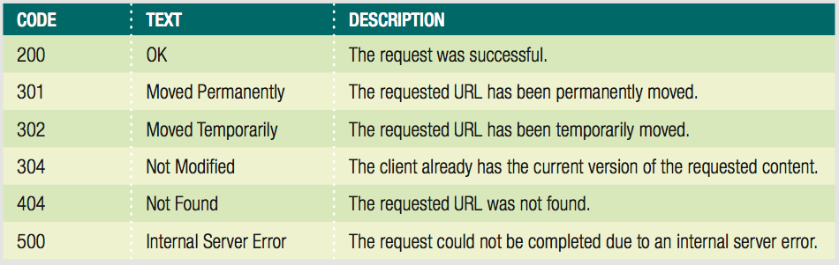
Receiving HTTP Responses (cont’d.)
  5xx: (server error) - Request cannot be fulfilled due to a server error
Table 11-3 Common response codes
JavaScript, Sixth Edition

Slide 27
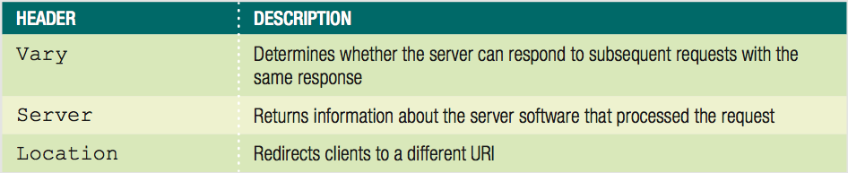
Receiving HTTP Responses (cont’d.)
Zero or more response headers follow the status line
Response returned from a server
  Can be much more involved than original request that generated it
Table 11-4 Common response headers
JavaScript, Sixth Edition

Slide 28
Requesting Server Data
XMLHttpRequest object
  Key to incorporating Ajax in JavaScript code
  Allows use of use JavaScript and HTTP to exchange data between a web browser and a web server
JavaScript, Sixth Edition

Slide 29
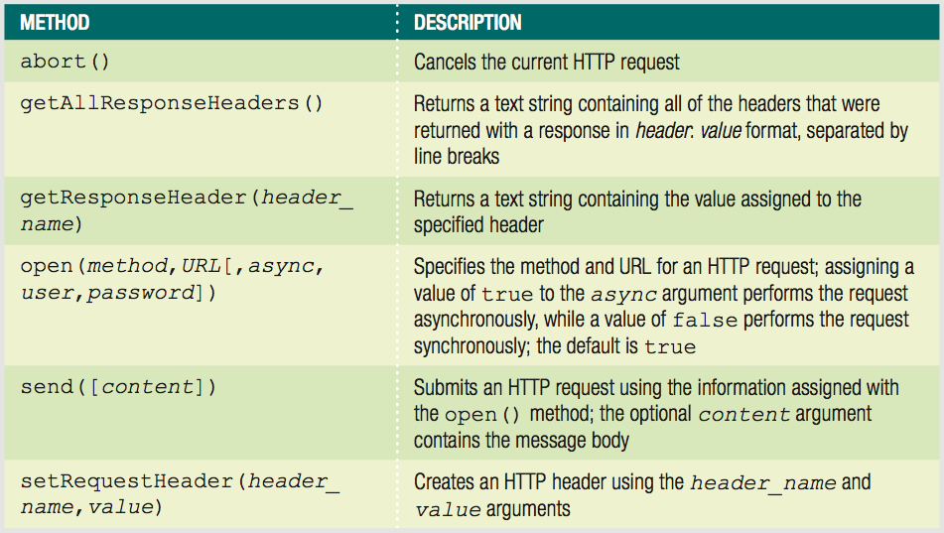
Requesting Server Data (cont’d.)
Table 11-5 XMLHttpRequest object methods
JavaScript, Sixth Edition

Slide 30
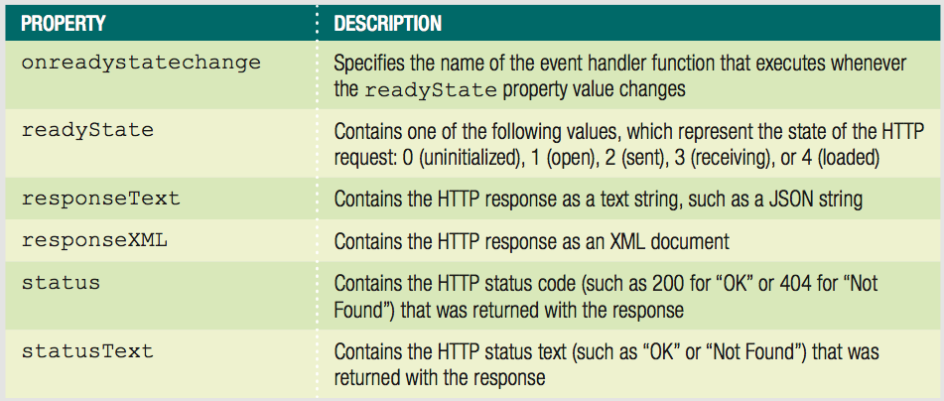
Requesting Server Data (cont’d.)
Table 11-6 XMLHttpRequest object properties
JavaScript, Sixth Edition

Slide 31
Instantiating an XMLHttpRequest Object
Use the XMLHttpRequest constructor
  var httpRequest = new XMLHttpRequest();
Originally created specifically to request XML data
  Name hasn't changed, but now capable of more
Most JavaScript programmers use a series of nested try/catch statements
Opening and closing HTTP connections is a bottleneck in page loading
  HTTP/1.1 automatically keeps the client-server connection open unless it is specifically closed
Can make Ajax programs faster by reusing an instantiated XMLHttpRequest object
JavaScript, Sixth Edition

Slide 32
Instantiating an XMLHttpRequest Object (cont’d.)
^{var curRequest = false;}
^{var httpRequest;}
^{function getRequestObject() {}
^{try {}
httpRequest = new XMLHttpRequest();
}
^{catch (requestError) {}
document.getElementById("main").innerHTML = "Your↵
browser does not support this content";
^{return false;}
}
^{return httpRequest;}
}
^{if (!curRequest) {}
curRequest = getRequestObject();
}
JavaScript, Sixth Edition

Slide 33
Opening and Sending a Request
Use the open() method with the instantiated XMLHttpRequest object
  To specify the request method (GET or POST) and URL
open() method accepts three optional arguments
  async, username, password
abort() method
  Used to cancel any existing HTTP requests before beginning a new one
JavaScript, Sixth Edition

Slide 34
Opening and Sending a Request (cont’d.)
send() method
  Submit the request to the server
  Accepts a single argument containing the message body
POST requests more involved
  Must manually build name-value pairs to submit
  Must submit at least Content-Type header before send() method
  Also should submit Content-Length header and Connection header
JavaScript, Sixth Edition

Slide 35
Receiving Server Data
responseXML property
  Contains the HTTP response as an XML document
  Only if server response includes the Content-Type header with a MIME type value of text/xml
responseText property
  Contains the HTTP response as a text string
JavaScript, Sixth Edition

Slide 36
Processing XML Data in a Response
Assign property values to document nodes
  Assign value of responseXML property to a variable
  Use innerHTML and node properties to assign values of XML document stored in variable to appropriate elements
JavaScript, Sixth Edition

Slide 37
Processing Text Data in a Response
responseText value almost always a JSON string
  First use JSON.parse() to convert to object
  Then access property values of new object and add to DOM elements
JavaScript, Sixth Edition

Slide 38
Sending and Receiving Synchronous Requests and Responses
Synchronous request
  Stops the processing of the JavaScript code until a response returned from the server
Check XMLHttpRequest object’s status property value
  Ensure response received successfully
JavaScript, Sixth Edition

Slide 39
Sending and Receiving Synchronous Requests and Responses (cont’d.)
Synchronous responses
  Easier to handle
Drawback
  Script will not continue processing until the response is received
Use asynchronous requests with the send() method
JavaScript, Sixth Edition

Slide 40
Sending and Receiving Asynchronous Requests and Responses
Asynchronous request
  Allows JavaScript to continue processing while it waits for a server response
Create an asynchronous request
  Pass a value of true as the third argument of the open() method
    Or omit the argument altogether
Receive a response
  Use the XMLHttpRequest object’s readyState property and onreadystatechange event
JavaScript, Sixth Edition

Slide 41
Sending and Receiving Asynchronous Requests and Responses (cont’d.)
Example:
  ^{stockRequest.abort();}
  stockRequest.open("get","StockCheck.php?" + "checkQuote=" +↵
  ^{tickerSymbol, true);}
  ^{stockRequest.send(null);}
  stockRequest.onreadystatechange = fillStockInfo;
JavaScript, Sixth Edition

Slide 42
Sending and Receiving Asynchronous Requests and Responses (cont’d.)
Value assigned to the readyState property
  Updated automatically
    According to the current statement of the HTTP request
If property assigned a value of 4
  Response finished loading
JavaScript, Sixth Edition

Slide 43
Sending and Receiving Asynchronous Requests and Responses (cont’d.)
Example:
  ^{function fillStockInfo() {}
  if (stockRequest.readyState === 4 && stockRequest.status↵
  ^{=== 200) {}
  var stockValues = stockRequest.responseText;
  document.getElementById("ticker").innerHTML =↵
  ^{stockValues.ticker;}
  ...
  }
  }
JavaScript, Sixth Edition

Slide 44
Refreshing Server Data Automatically
Automatically refresh data obtained from an HTTP server
  Use JavaScript’s setTimeout() or setInterval() methods
    Send request to the server
    Read and process the data returned from the server
JavaScript, Sixth Edition

Slide 45
Creating Cross-Domain Requests Without a Proxy Server
Two alternatives to proxies for working around same-origin policy
  JSON-P (JSON with padding)
    Requests JSON content using a script element rather than an XHR object
  CORS (Cross-Origin Resource Sharing)
    Server sends special response header that indicates data may be used on other domains
JavaScript, Sixth Edition

Slide 46
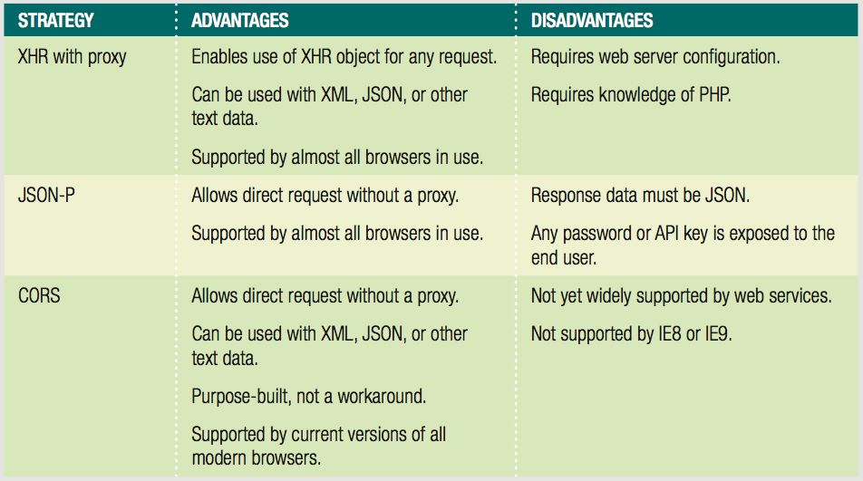
Creating Cross-Domain Requests Without a Proxy Server (cont'd.)
Table 11-7 Comparison of XHR proxy, JSON-P, and CORS
JavaScript, Sixth Edition

Slide 47
Updating Content with JSON-P
script element not subject to same-origin policy
Program running on web server returns content
  JSON object treated as parameter for function call
  Called function processes JSON object
JavaScript, Sixth Edition

Slide 48
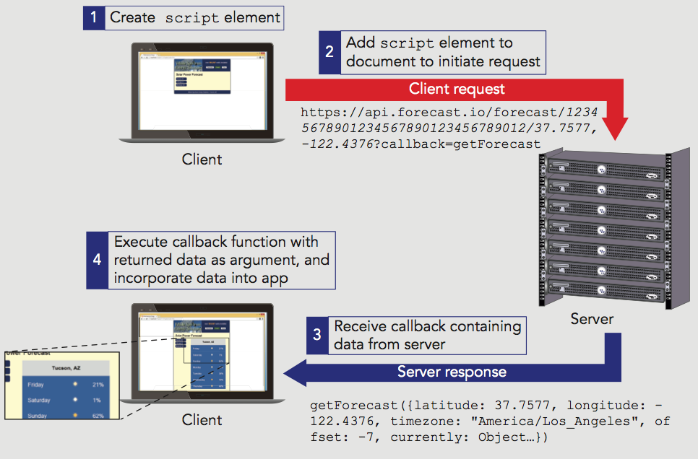
Updating Content with JSON-P (cont'd.)
Figure 11-14 Using JSON-P to update data
JavaScript, Sixth Edition

Slide 49
Updating Content with JSON-P (cont'd.)
JSON-P URL generally consists of 2 parts:
  Request information
    URL of service, parameters
  Callback query string
    Keyword (usually "callback") & name of function to call
JavaScript, Sixth Edition

Slide 50
Updating Content with JSON-P (cont'd.)
JSON-P opens a security hole in your website
  If data source compromised, content you receive is a potential attack route on your site
  Use JSON-P only with web service you trust
JSON-P exposes API key or password to end users
  Use only with trusted users, such as employees
JavaScript, Sixth Edition

Slide 51
Updating Content with CORS
Cross-domain request within an XHR object
Part of XMLHttpRequest2 specification
  Additional properties, methods, and events for XHR object
Enables content provider to convey permission
  Access-Control-Allow-Origin HTTP response header
    Value includes requesting domain
  XDomainRequest object (Microsoft)
    Must check first if browser defines this object
JavaScript, Sixth Edition

Slide 52
Summary
Ajax allows data exchange with web server without reloading page
XMLHttpRequest object
  Uses HTTP to exchange data between a client computer and a web server
Proxy is common technique for working around same-origin policy with Ajax
HTTP defines rules for requests and responses between client and server
JavaScript, Sixth Edition

Slide 53
Summary (cont’d.)
Use methods and properties of an instantiated XMLHttpRequest object with JavaScript
First step to exchange data between an HTTP client and a web server
  Instantiate an XMLHttpRequest object
To improve performance
  Call the abort() method of the XMLHttpRequest object
Use the send() method with the instantiated XMLHttpRequest object to submit the request to the server
JavaScript, Sixth Edition

Slide 54
Summary (cont’d.)
Server response assigned to responseXML or responseText property
Synchronous request stops the processing of the JavaScript code until a response returned
Asynchronous request allows JavaScript to continue processing while waiting for a server response
readystatechange event fires when value assigned to readyState property changes
JavaScript, Sixth Edition

Slide 55
Summary (cont’d.)
JSON with padding (JSON-P) requests JSON content using script element rather than XHR object
Cross-Origin Resource Sharing (CORS)
  Server sends HTTP response header indicating data may be used on other domains
JavaScript, Sixth Edition

